Slide 1
Network Visualization

Slide 2

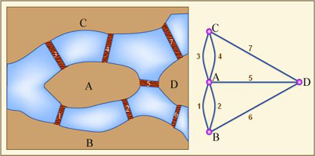
Network Data (Graph)
A very hot topic
Social networks
Network analysis is not a new area!
It is very old.

Slide 3
Compared with Hierarchy Data
Relationship is more complicated.
Between any two vertex
With direction
With weight
But same goals
Presentation of vertex and edges
Interaction

Slide 4
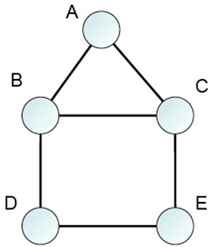
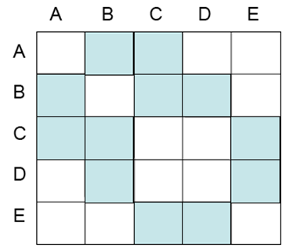
Classification
Node-link
Matrix
Hybrid

Slide 5
Node-Link
Main challenge
A good layout of vertex to reduce visual complex.
A popular technique: Force-directed graph drawing
Each pair of nodes are connected by a “spring”.

Slide 6
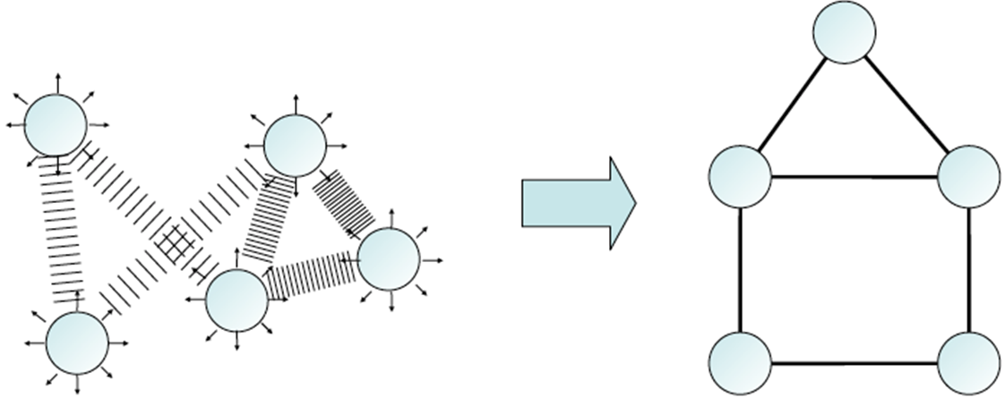

Slide 7
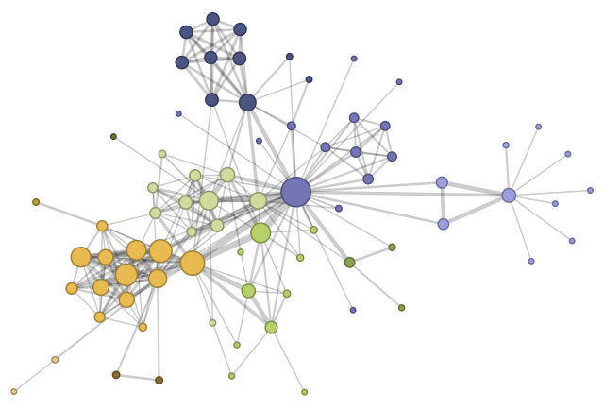
Character co-occurrence in Les Misérables
http://hci.stanford.edu/jheer/files/zoo/

Slide 8
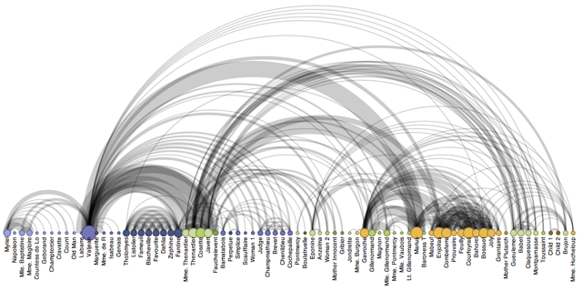
Variations: Arc Diagram
http://hci.stanford.edu/jheer/files/zoo/

Slide 9
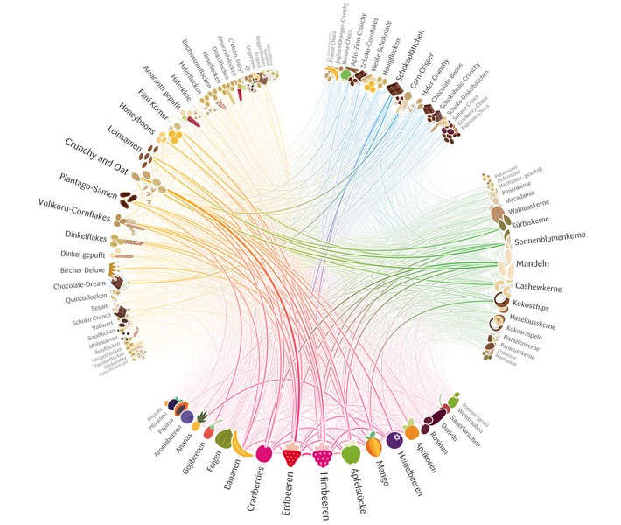
Variations: Radial Network

Slide 10
Node-Link Layout
Pros
Direct and easy to understand
Cons
Results are sensitive to initial positions of vertex
High computational complex
Visual complexity for large networks
Not stable

Slide 11
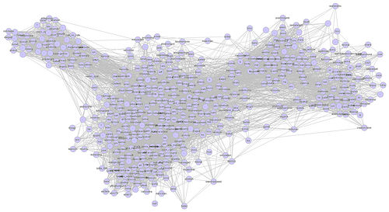
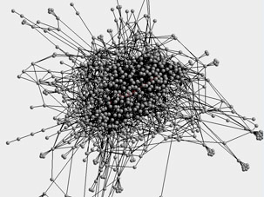

Slide 12
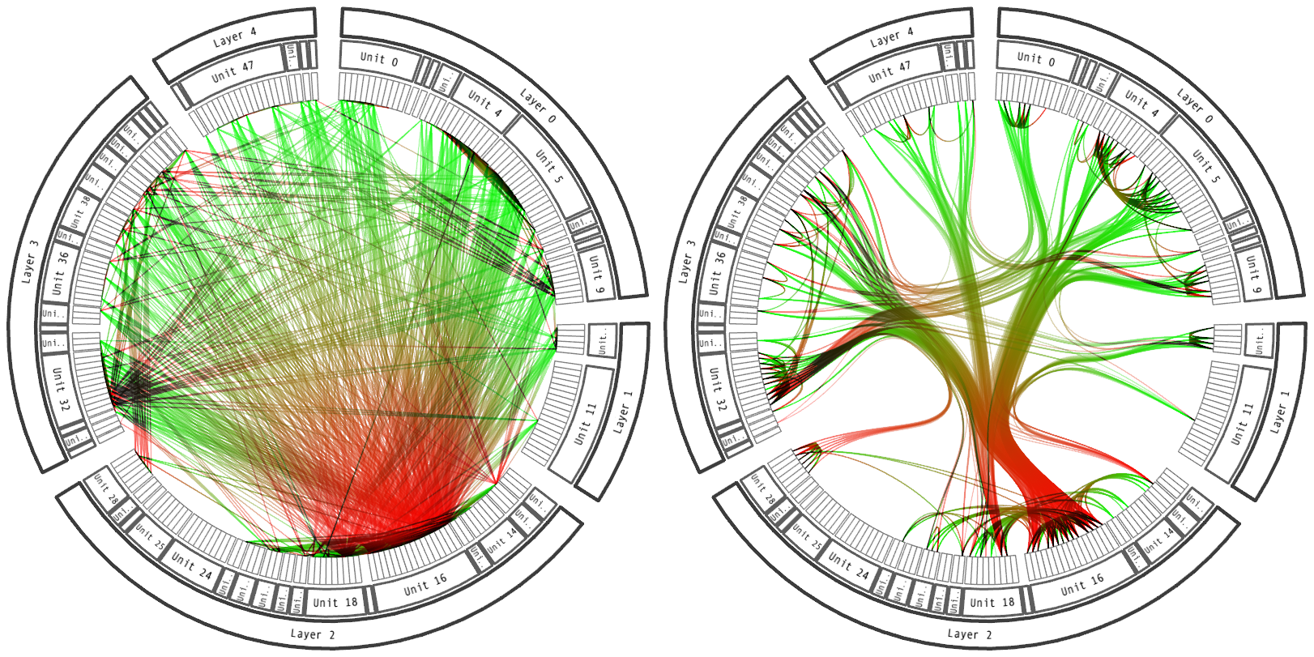
Edge Bundling

Slide 13
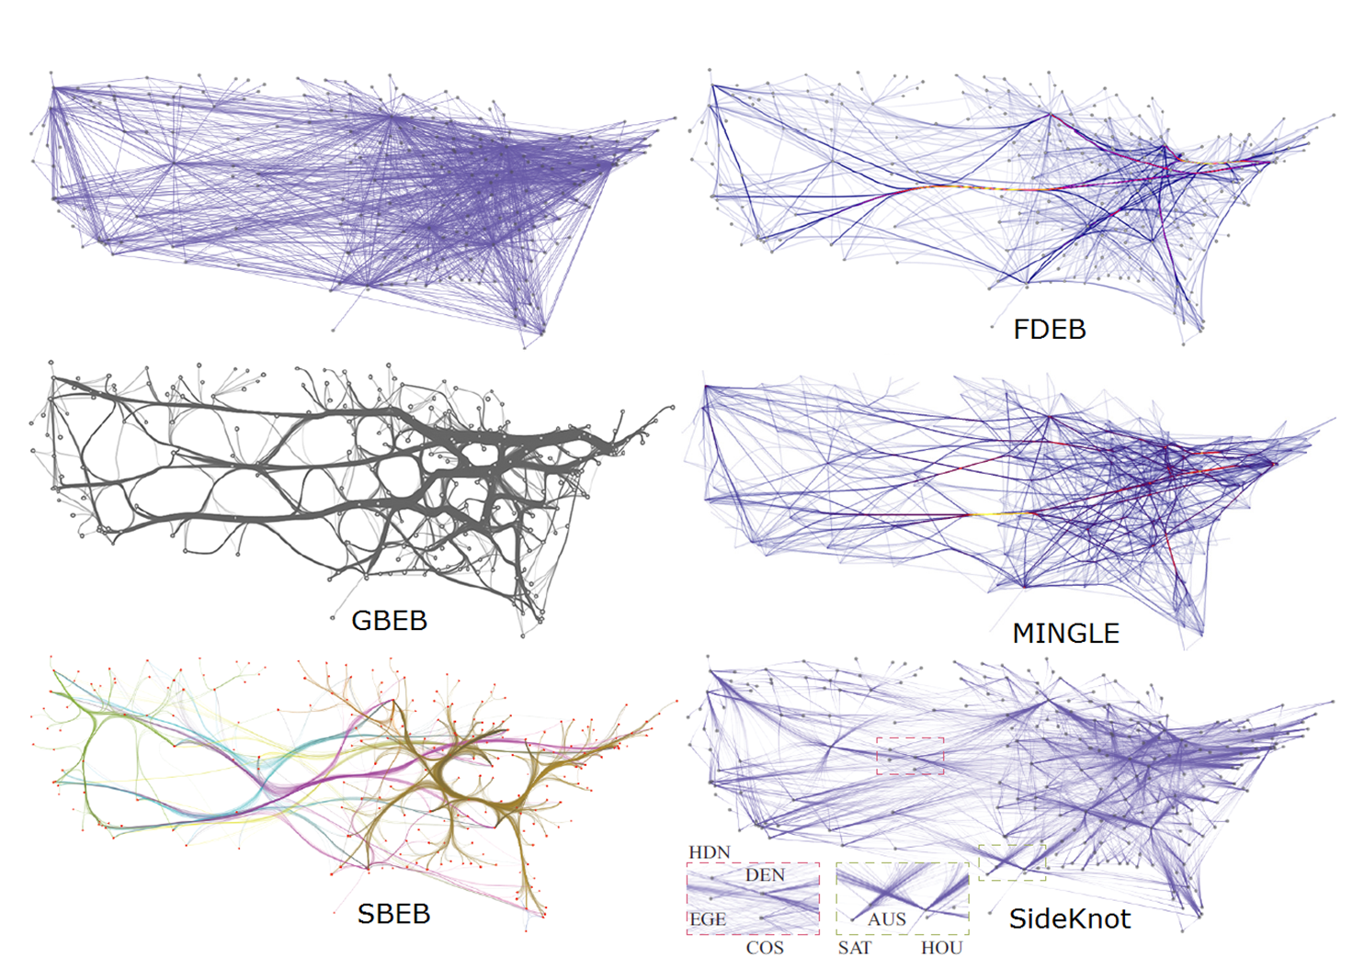

Slide 14
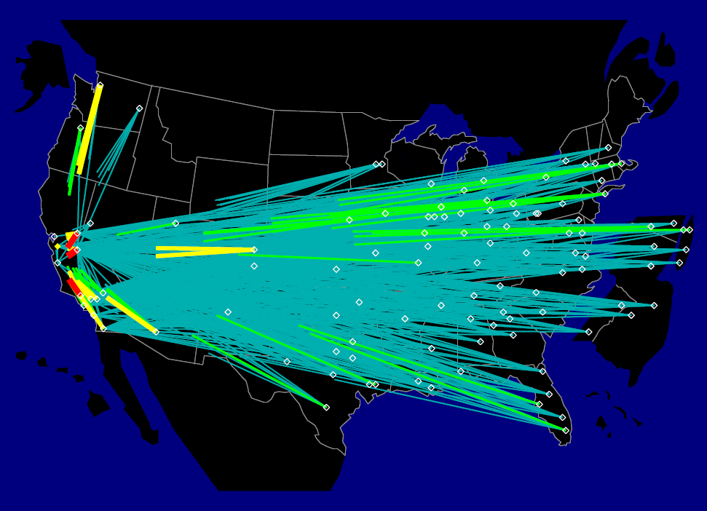
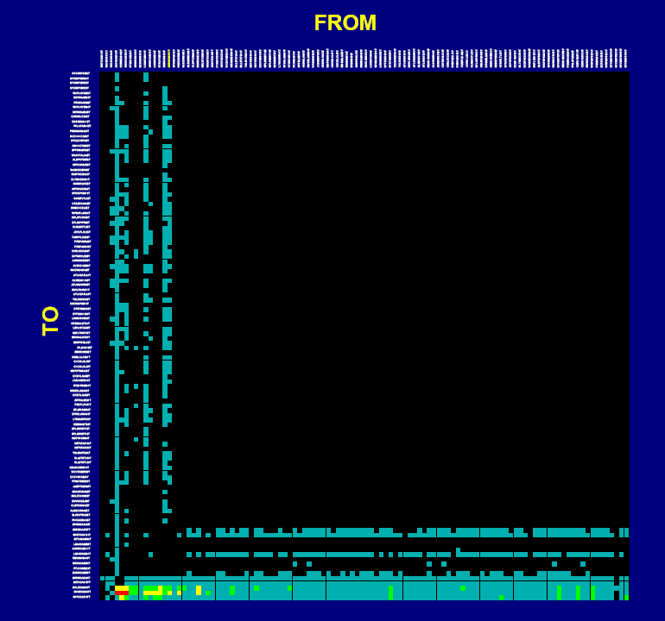
Matrix

Slide 15
Basic Idea
N x N matrix
N: the number of nodes
The intersection of row and column: relationship
Can embed direction, weight inforamtion

Slide 16
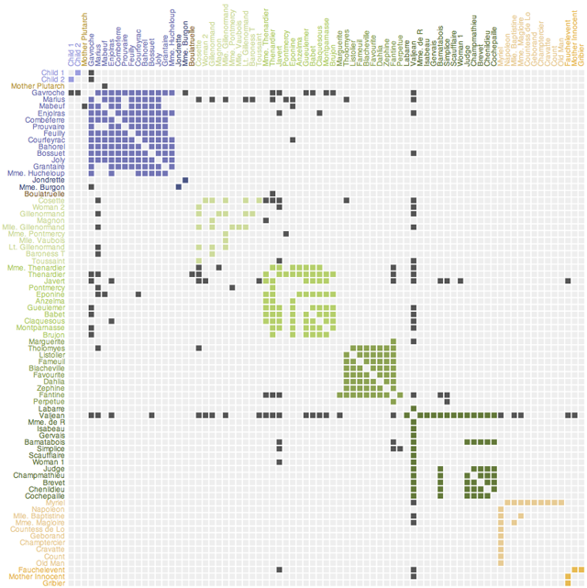
http://hci.stanford.edu/jheer/files/zoo

Slide 17
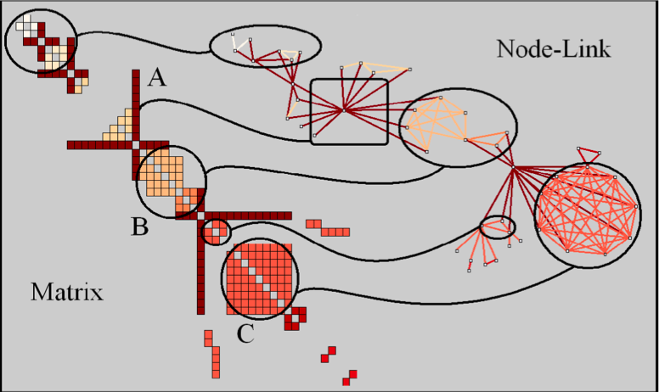
How to Read a Matrix Representation

Slide 18
How to Follow a Path

Slide 19
Hybrid Approaches
NodeTrix
Demo
http://www.youtube.com/watch?v=7G3MxyOcHKQ

Slide 20
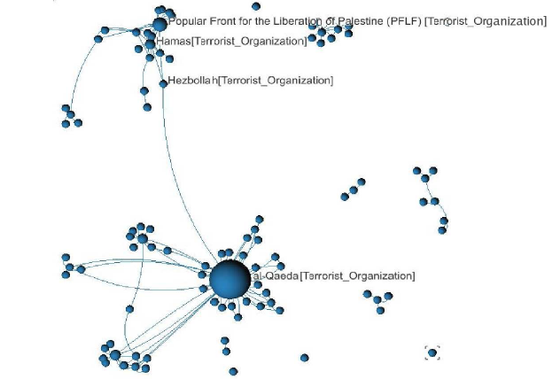
Emphasizing “Social” in Social Network Visualization
Considering the attribute information of nodes and edges

Slide 21
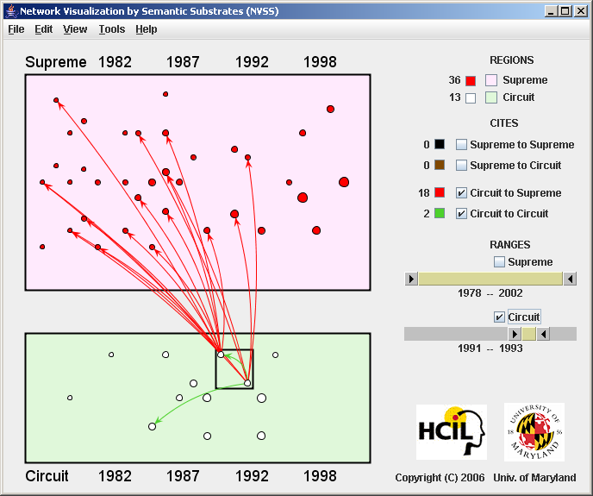
http://hcil2.cs.umd.edu/video/2006/substrates.mpg

Slide 22
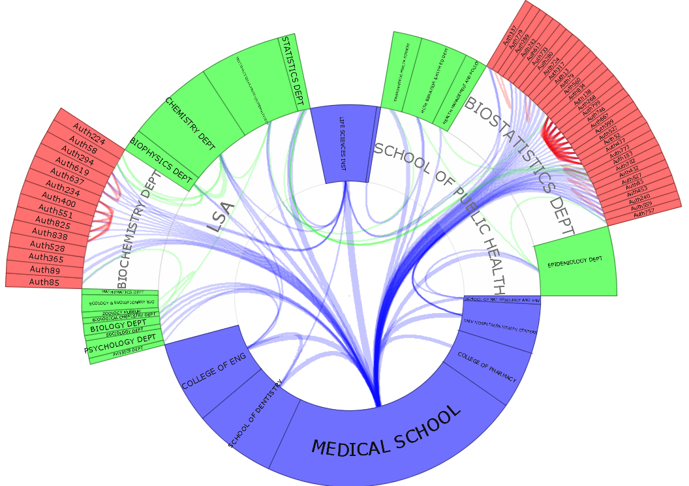
http://zhang.ist.psu.edu/demo/SocialNetSense/TreeNetViz.mov

Slide 23
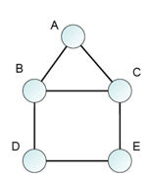
Network Data Format
Various formats are used by different software tools.
Can be simple
Or complicated
source, target
a,b
a,c
b,c
.
d,e
Vertices
1 “a”
2 “b”
3 “c”
4 “d”
5 “e”
Arcs
1 2
1 3
2 3
.
4 5
source, target, weight
a,b,1
a,c,1
b,c,1
.
d,e,1

Slide 24
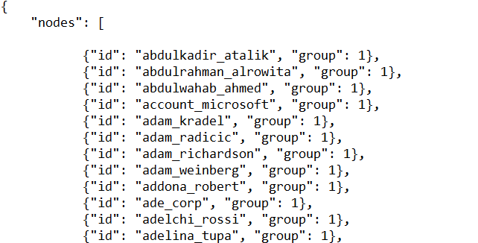
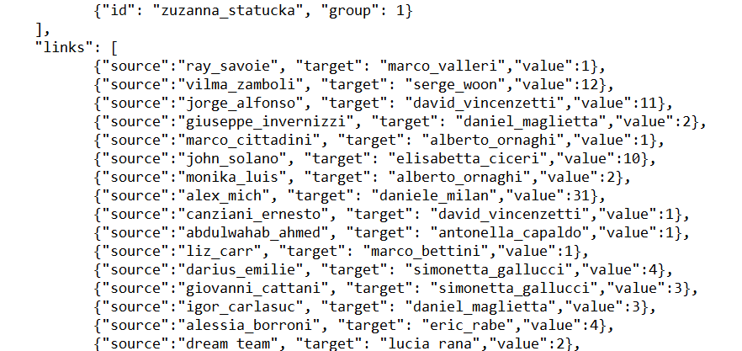
.
.
.
.
]
}

Slide 25
Work on Your Data
Excel is your best friend (probably).
Easy to create cells with certain patterns
Picked up by Excel or defined by users
Analytical tools to generate necessary data

Slide 26
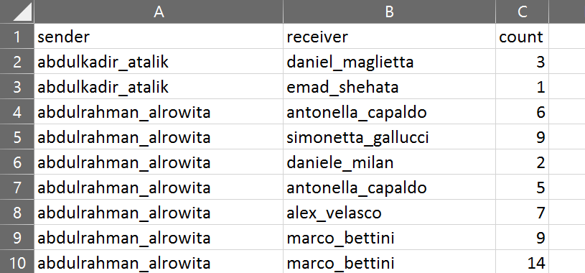
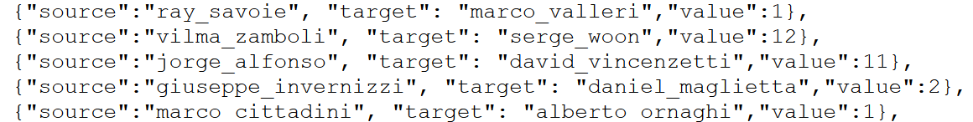
Format data for JSON: Links
What you have
Your goal

Slide 27
Format data for JSON: Nodes
All nodes are there: links are defined by nodes.
What we need is a list of unique nodes.
Excel: Pivot Table tool

Slide 28
Python

Slide 29
Why Do We Need Python?
Python is very powerful in processing data.
Various libraries available for people to use directly
No need to write codes for basic tools
Data analytics, natural language processing, graphics, …
Programming is relative easy.
Compared with Java, C++/C
Visualization requires better structured data.
Python can prepare for such data.

Slide 30
A Few Points about Python
Easy to install and use
Available for all major OSes.
Lots of resources on the Internet
Tutorials, codes, books, …
Pay attention to versions
2.7 and 3.5 different significantly.
Having Python on your own computer
Strongly recommended

Slide 31
Python in Our Classroom/VLab
Python, IPython, python GUI
Various problems
Jupyter Notebook
User friendly

Slide 32
Exercise: Using Python to Understand Cars Data
Goals:
Conduct basic analysis of car data
cars.csv used for parallel coordinates
Copy the cars.csv from your web space to your Documents folder (under the This PC class)
Start Jupyter Notebook
Open pythonExercise1.pdf under the InClassExercisesResources\Week7_Python folder
Type in each command
You must type in every command!

Slide 33
Library Packages Involved in This Exercise
Numpy: the fundamental package for scientific computing
pandas: PANel DAta System
matplotlib: a plotting library for high quality figures

Slide 34
pandas Basics
DataFrame
A 2-dimensional, tabular structure (like a spreadsheet)
Series
A 1-dimensional, list structure
Each column in a dataframe is a series
Column is retrieved by column name.
Row is retrieved by index number

Slide 35

More Resources
Reading
Chapter 5 -8
Cheat sheets
PythonCheatSheets under InClassExercisesResources

